Slide 1
Subject: DRAMA
Term: FIRST TERM
Session : 2023/2024
Class : GRADE 9
Educator: MR SHITTU T. ABIODUN
Compiled by: MR SHOTOMIDE OLAOYE

Slide 2
SCHEME OF WORK
WEEK 1:
HISTORY AND ORIGIN OF DRAMA
DEFINITION OF DRAMA AND TYPES OF DRAMA
WEEK 2
WEEK 3:
FORMS OF DRAMA AND THE MEANINGS
IMPORTANCE OF DRAMA
WEEK 4
WEEK 5:
FUNCTIONS OF DRAMA
DEFINITION AND TYPES OF DANCE
WEEK 6
WEEK 7:
MID-TERM BREAK
FUNCTIONS OF DANCE
WEEK 8
WEEK 9:
TRADITIONAL DANCE IN NIGERIA
POPULAR NIGERIAN DANCERS
WEEK 10
WEEK 11:
REVISION
EXAMINATION
WEEK 12

Slide 3
TOPIC: INTRODUCTION TO DRAMA>>
At the end of this lesson, students should be able to:
Discuss the history of drama,
Mention some traditional dance in Nigeria and
State traditional dance in Nigeria according to their rating.
HISTORY AND ORIGIN OF DRAMA
HOMER PAGE
HOME PAGE
The theatrical culture of the city-state of Athens produced three genres of drama which are tragedy, comedy and the satyr play.

Slide 4
HISTORY AND ORIGIN OF DRAMA
1.The earliest origins of drama are to be found in Athens (Greece) where ancient hymns, called dithyrambs, were sung in honor of the god Dionysus.
2. The first plays were performed in the Theatre of Dionysus, built in the shadow of the Acropolis in Athens at the beginning of the 5th century, the theatre proved to be so popular that the information spread all over Greece.
3.The play was performed with just one actor called a protagonist and a chorus of people who helped to tell the story. However, throughout the 5th century BC ,playwrights continued to innovate new ideas. The three popular playwrights at that period were: Aeschylus, Sophocles and Euripides.
4.The playwright Aeschylus added a second speaking role, called the antagonist, and reduced the chorus from 50 to 12. His play 'The Persians', first performed in 472 BC, is the oldest surviving of all Greek plays.

Slide 5
TOPIC: HISTORY OF DRAMA>>
5.His pupil, Sophocles went on to add a third actor, while Euripides added both a prologue, introducing the subject of the play.
6.Further development came later in the 6th century BC, when the tyrant Pisistratus, who then ruled the city called ‘Dionysia', established a series of new public festivals of entertainment held in honor of the god Dionysus; featured competitions in music, singing, dance and poetry. And most remarkable of all the winners was said to be a wandering bard called Thespis.
7.According to tradition, in 534BC, Thespis astounded audiences by leaping on the back of a wooden cart and reciting poetry as if he was the character whose lines he was reading. In doing so he became the world's first actor, and it is from him that we got the world thespian.
8.At that period, drama was classified according to three different types or genres: Comedy, Tragedy and Satyr plays.

Slide 6
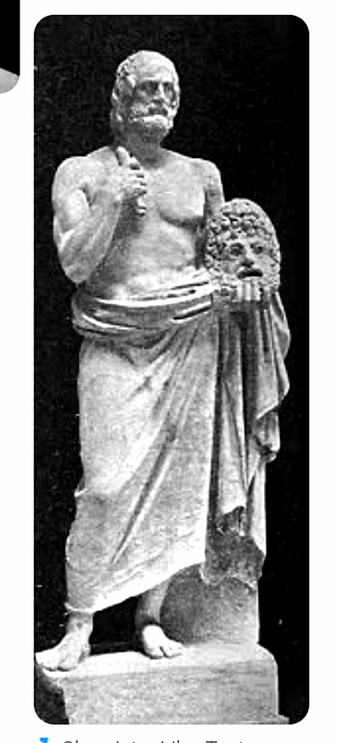
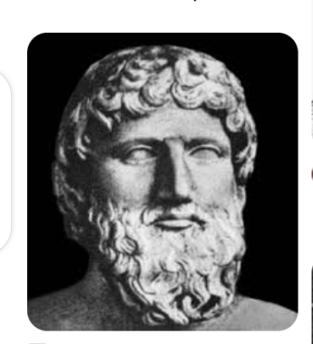
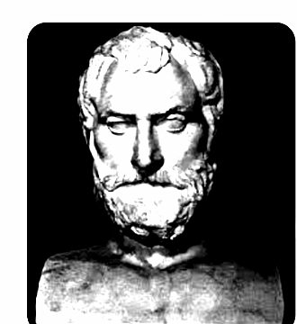
AESCHYLUS

Slide 7
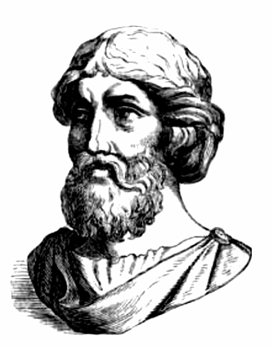
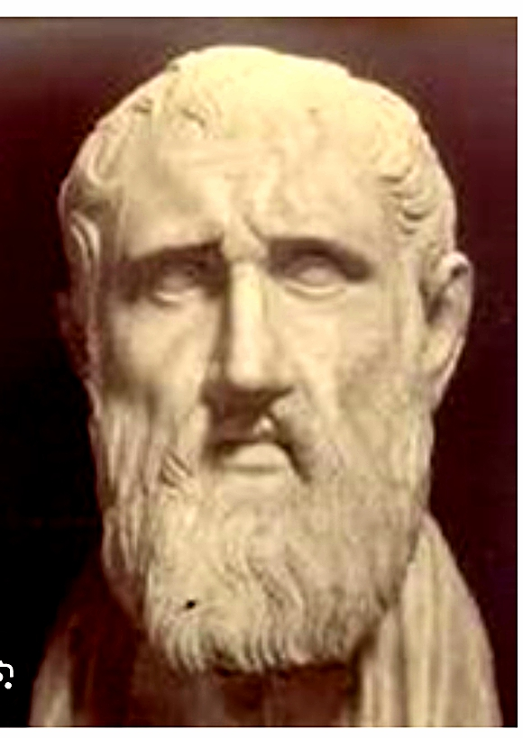
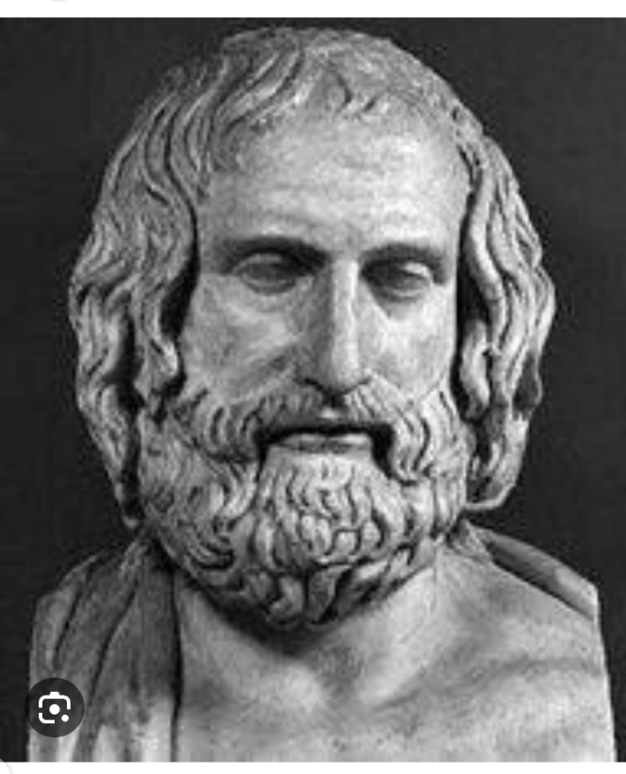

Slide 8
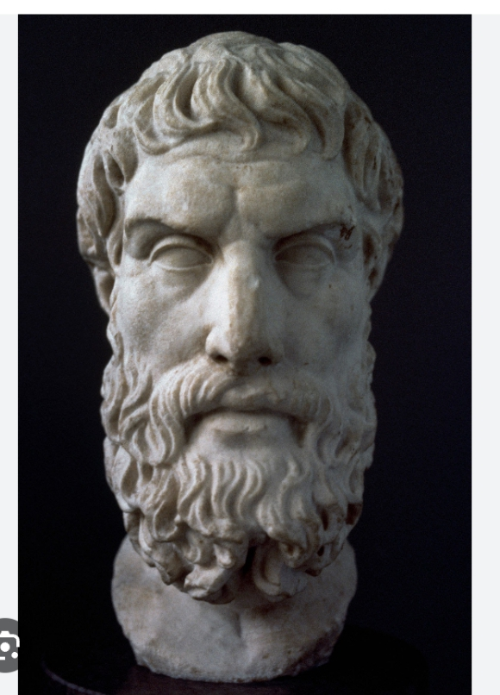
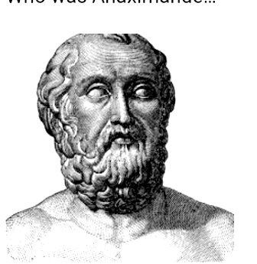

Slide 9
TOPIC: CLASS WORK>> Evaluation ONE
Question 1
Discuss briefly the origin of drama.
Question 2
State three famous ancient playwrights in drama history.
ASSIGNMENT: Explain how drama was invented.

Slide 10

Any Questions?

Slide 11
TOPIC: DEFINITION OF DRAMA>>
At the end of this lesson, students should be able to:
Define drama,
Mention the main types of drama and
Discuss the two main types of drama.
MEANING OF DRAMA AND TYPES
HOME PAGE
Drama is a daily activity that is acted on the stage. The world is the stage while humans are the actors and actresses.

Slide 12
DRAMA is defined as the art of entertainment created or performed in front of an audience or spectators on stage with comical or tragic plays in order to educate or entertain them.
It is also a literary composition involving performance on stage before the audience.
THEATRE is defined as a hall or room in which dramatic entertainment are presented. It is a building furnished with comfortable seats and well positioned stage upon which actors, dramatists, musicians and other performing artists stage their plays, film shows and fashion parades.
TOPIC: MEANING OF DRAMA>>

Slide 13
TYPES OF DRAMA
There are two main types of drama which are;
Scripted drama and
Non-scripted drama

Slide 14
Scripted drama is a type of drama that is written down inform of a document which must be read and memorized before it is acted on the stage in front of the audience.
Non-scripted drama is a type of drama that is verbally explained to the cast before it is acted on the stage in front of the audience. It is also called improvisational or unwritten drama.

Slide 15
Drama Terminologies
The following are some drama terminologies.
Diction
Plot
Script
Stage
Cast
Sound
Characterization
Spectacle
Epilogue
prologue

Slide 16
TOPIC: CLASS WORK >> Evaluation Two
Question 1
What is drama?
Question 3
Which of the types of drama is an improvised drama.
Question 2
What are the types of drama?
Question 4
List five drama terminologies

Slide 17
Any Questions?

Slide 18
TOPIC: CONTINUATION OF DRAMA>>
At the end of this lesson, students should be able to:
State at least five forms of drama,
Explain at least three forms of drama and
Differentiate some of the forms of drama.
FORMS
OF DRAMA AND THEIR MEANING
HOME PAGE
Drama is a daily activity that acted on the stage. The world is the stage while humans are the actors and actresses.

Slide 19
The following are forms of drama.
TOPIC: FORMS OF DRAMA>>
Tragedy drama 8. Dramatized folktale
Comedy drama 9. Dance drama
Farce drama 10.Mime
Melodrama
Tragi-comedy drama
Opera( music drama)
Mask drama

Slide 20
Tragedy: This is a form of drama that is serious with tragic moments which can end good or bad. It is a drama involves the run or death of the leading characters in most cases.
Comedy: This is a form of drama that is created to amuse the audience from the beginning to the end by a comedian. Comedy helps to relief the tension of the audiences through jokes and fun.
Farce: This is a drama form in which the characters are funny and hilarious at the same time without regard for human values.
Tragi-comedy: This is a form of drama that is combined to create tension and funny characters at the same time. It is created to reduce the over serious mood of the audience while seeing the performance on stage.

Slide 21
TOPIC: CLASS WORK >> Evaluation one
Question 1
List five forms of drama.
Question 3
What is the difference between comedy and farce drama?
Question 2
Explain three of them.
Question 4
Differentiate between tragedy drama and tragi-comedy drama.

Slide 22
Fantasy: This is sometimes a play but not always in comic spirit in which the author gives free reign to his fantasy, allowing things to happen without regard to reality.
Melodrama: This is like a farce, melodrama pays almost no attention to human values, but its objective is to give a thrill instead of laughter.
Comedy of Manners: This is a comedy which wittily portrays fashionable life.

Slide 23
TOPIC: CLASS WORK >> Evaluation Two
Question 1
What is a tragedy?
Question 3
State Five people who are involved in drama.
Question 2
what is a farce drama?
Question 4
Explain the meaning of at least three terms in drama.

Slide 24
Any Questions?

Slide 25
TOPIC: IMPORTANCE OF DRAMA>>
At the end of this lesson, students should be able to:
State the importance of drama,
Explain the major role of drama in the society.
List the people involved in drama presentation
IMPORTANCE
OF DRAMA
HOME PAGE
Constructive criticism, Personal development, Competency, leadership skill and problem –solving.

Slide 26
THE FOLLOWING ARE SOME IMPORTANCE OF DRAMA IN EDUCATION.
TOPIC: IMPORTANCE OF DRAMA>>
Teaches Self-Expression:
Life Skill Training: It imparts students with various life skills like teamwork, compassion, cooperation and collaboration.
Constructive Criticism
Contributes to Personality Development
Helps to discover students inner talents, skills, competency and unique voice
It acts as a booster and problem-solving skills to students
Students learn to be a good leader through drama

Slide 27
TOPIC: THE ROLES OF DRAMA IN THE SOCIETY
Drama helps us to see life from another perspective
It reminds us that we are not alone.
Drama is immediate, evolving and always different because no two performances are ever the same.
Live drama helps to promote social discourse, dialogue and potential social change.
Drama promotes education and literacy. Studies have shown that students who participate in theatre do better in school.

Slide 28
Those who are involved in drama presentation
Cast
Director
Producer
Cameraman
Photographer
Stage manager
Costume manager
Make-up artist
Prompter
Light effect manager
Sound effect manager Etc.

Slide 29
TOPIC: CLASS WORK >> Evaluation one
Question 1
List five importance of drama.
Question 3
Why is drama needed in school?
Question 2
List five people that are involved in drama presentation
Question 4
Mention four roles of drama in our society.

Slide 30
Any Questions?

Slide 31
TOPIC: FUNCTIONS OF DRAMA>>
At the end of this lesson, students should be able to:
State at least four functions of drama,
Discuss some of the functions of drama and
FUNCTIONS OF DRAMA
HOME PAGE
EMPATHY, HIERARCHY, ORIENTATION, FORSTER, TOLERANCE, COMPASSION, COLLABORATION , CRITICISM, COMPETENCY.

Slide 32
The following are some functions of drama.
TOPIC: FUNCTIONS OF DRAMA>>
The roles that drama in the society cannot be overemphasized because they are very important to the standard of living of people. The list of functions below are some of the drama roles in the society.
It unites different people together
It is educative
It boost self confidence
It makes people better thinkers
It helps to develop people’s ability and skills to be focus.

Slide 33
It creates mutual relationship – ability to work with others.
It improves both verbal and nonverbal communications.
It reduces stress
It improves and exercises the brain.

Slide 34
TOPIC: CLASS WORK >> Evaluation one
Question 1
State five functions of drama
Question 2
Discuss briefly how drama reduces stress?

Slide 35
Any Questions?

Slide 36
TOPIC: HISTORY AND DEFINITION OF DANCE>>
At the end of this lesson, students should be able to:
Discuss the history of dance,
Briefly explain the origin of dance and
Define dance.
DEFINITION AND TYPES OF DANCE
HOME PAGE
Specific and newer dances have more particular beginnings, like the salsa, which was invented in Cuba during the late 19th century.

Slide 37
TOPIC: history OF DANCE>>
The earliest historical records showing the origins of dance are cave paintings in India dating to about 8000 BCE. Egyptian tomb paintings also depict dance in about 3300 BCE. These early dances may have been religious in nature, and by the era of ancient Greece, people were incorporating dance into celebrations of the wine god Dionysus (and later the Roman god Bacchus) and into ritual dances at the ancient Greek Olympic Games. In addition, early people danced for enjoyment, seduction, and entertainment.

Slide 38
These days, people chose dancing for various purposes like continuing the family legacy, improving the physical and mental health, as an occupation etc. With the increasing demand in creativity, dance forms also emerged quickly, and now in the present day, we have different dance forms based on different regions, cultures, religions, etc.

Slide 39
TOPIC: CLASS WORK >> Evaluation one
Question 1
List four reasons why people chose dancing.
Question 2
The origin of dance is traced to what date?

Slide 40
TOPIC: ORIGINS OF DANCE>>
No singular country can singularly be credited for the invention of dance, but historians have traced some ancients dances from 9000 years ago back to modern day India. Cave painting depicted people dancing with others playing instruments! Some traditional dances today can still be traced back to ancient India, Greece, Rome, and china, where civilizations and arts flourished.
Specific and newer dances have more particular beginnings, like the salsa, which was invented in Cuba during the late 19th century. The tango, meanwhile, was created in Argentina with Africa and Europeans influence.

Slide 41
WHAT IS DANCE?
Dance is the movement of the body in a rhythmic way, usually to music and within a given space, for the purpose of expressing an idea or emotion.

Slide 42
TOPIC: CLASS WORK >> Evaluation one
Question 3
What is dance to you?
Question 4
Mention some benefits of dance.

Slide 43
Any Questions?

Slide 44
TOPIC: FUNCTIONS AND BENEFITS OF DANCE>>
At the end of this lesson, students should be able to:
State the functions of dance,
List some benefits of dance and
Types of dance.
FUNCTIONS OF DANCE
HOME PAGE
These days, people chose dancing for various purposes like continuing the family legacy, improving the physical and mental health,…

Slide 45
WHAT IS DANCE?
Dance is the movement of the body in a rhythmic way, usually to music and within a given space, for the purpose of expressing an idea or emotion.

Slide 46
TOPIC: TYPES OF DANCE.>>
The following are some of the various types of dance.
Ballet dance
Salsa dance
Hip-hop dance
Tango dance
Tap dance
Break dance
Rock and roll dance
Reggae dance
Traditional dance
Religious dance etc.

Slide 47
BENEFITS OF DANCE
For better brain health
To improve flexibilities
To minimize stress
To reduce depression
To increase weight loss
To also increase level of energy
To increase your self-esteem and confidence.

Slide 48
TOPIC: FUNCTIONS OF DANCE>>
Dance is used as a symbol of cultural identity.
It is used as an expression of religious worship
It is also used as an expression of power and social order
Dance is used for cultural morals and values in the society
It is used for socialization and communication
It is used for entertainments
It is also used for physical and mental fitness
It is also used to release stress and societal pressure.

Slide 49
TOPIC: CLASS WORK >> Evaluation one
Question 1
Mention five types of dance.
Question 2
List four benefits of dance.

Slide 50
Any Questions?

Slide 51
TOPIC: CONTINUATION OF DANCE>>
At the end of this lesson, students should be able to:
Discuss the meaning of traditional dance,
Differentiate between some traditional dance in Nigeria and
State four traditional dance in Nigeria according to their rating.
TRADITIONAL DANCE IN NIGERIA
HOME PAGE
These days, people chose dancing for various purposes such as preserving the family legacy, improving the physical and mental health and others

Slide 52
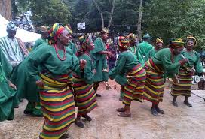
Traditional dance in OSUN STATE

Slide 53
What is traditional dance?
Traditional Dance forms (often called Folk dances in the West) can be defined as any local dancing tradition, often strongly connected with local musical forms and/or local beliefs.

Slide 54
TOPIC: TRADITIONAL DANCE IN NIGERIA>>
There are several types of traditional dance in Nigeria. The following are some of the most popular traditional dance in Nigeria.
Atilogwu dance from the eastern part of Nigeria.
Sharo dance from the northern part of Nigeria.
The koroso dance from the northern part of Nigeria.
Bata dance from the western part of Nigeria.
Nkwa umu agbogho from the eastern part of Nigeria.

Slide 55
6. Ikpirikpi ogu dance from the east
7. Gese dance in Western Nigeria.
8. Swange dance from the Tiv people
9. Ogene dance from the Eastern state.
10. Ekombi dance from Cross river state

Slide 56
TOPIC: FEATURES OF COMPUTERS>> Evaluation
Question 1
What is traditional dance?
Question 2
State five traditional dance in Nigeria.

Slide 57
Any Questions?

Slide 58
TOPIC: CONTINUATION OF DANCE>>
At the end of this lesson, students should be able to:
List some Nigerian popular dancers,
Discuss briefly their biography and
Discuss the benefits of being a dancer.
POPULAR NIGERIAN DANCERS
HOME PAGE
These days, people chose dancing as a profession and has brought fame to some even globally.

Slide 59
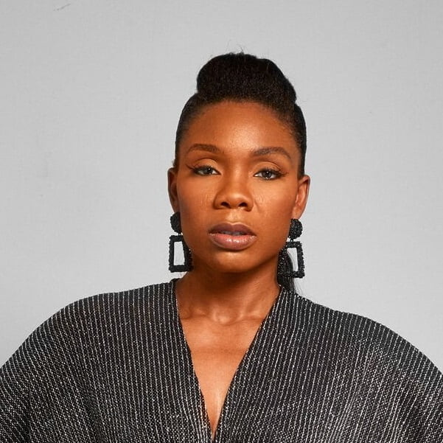

POPULAR NIGERIAN DANCERS

Slide 60
Nigerian dancers
Kafayat Oluwatoyin Shafau (a.k.a kaffy) is a Nigerian dancer, choreographer, dance instructor, and fitness coach. She is the founder and owner of the Imagneto Dance Company.
Nneka Irobunda (a.k.a Delacyn) is a Nigerian-born dancer, choreographer, and creative director. She has a BA in Psychology and Dance and is trained in diverse styles of dance.
Stephen Ojo (a.k.a.Stephen Papi Ojo is) a Nigerian dancer, model, actor, and musical artiste. He came to the limelight after he featured as a dancer in Beyoncé’s dance video, Already. Although he is based in the United States, he is one of the best dancers in Nigeria with so much energy and creativity.

Slide 61
TOPIC: TRADITIONAL DANCE IN NIGERIA>>
Sarah Olaniran (a.k.a Sayrachips) is a Nigerian dancer based in the United States. She is also a choreographer and fitness coach who was tutored by Kaffy before she finally left Nigeria. She took a 4 year Dance Degree program at Columbia College in Chicago, America.
Korra Obidi is one of the most flexible and best dancers in Nigeria. She is a Nigerian born dancer, choreographer and singer who resides in the United States. Asides from being talented as a dancer, she is also a talented singer and a writer.

Slide 62
Others are;
Odumewu Sunmisola Debbie (a.k.a Pinki Debbie)
Susan Olayungbo (a.k.a Nigerian Jawn)
Izzy Odigie
Meka Oku
A.kay_xx,etc.

Slide 63
Benefits of being a dancer are;
Health and Confidence
Survival Skills
Life Skills
Positive Attitude
The Bigger Picture

Slide 64
TOPIC: FEATURES OF COMPUTERS>> Evaluation
Question 1
Mention four popular dancers in nigeria and their real names.
Question 2
Who is the dancer to Beyoncé among the artistes?

Slide 65
Any Questions?

